Slide 1
Heart Attack Prediction
Submitted By
Athul P

Slide 2
Introduction
Health care field has a vast amount of data, for processing those data certain techniques are used. Machine Learning is one of the techniques often used. Heart disease is the Leading cause of death worldwide. This System predicts the arising possibilities of Heart Disease. The outcomes of this system provide the chances of occurring heart attacks.

Slide 3


Intro
What is Heart Attack .How to prevent them?
Current System ECG & Blood Test.
Our System Based some measurements.

Slide 4

A heart attack occurs when the flow of blood to the heart is blocked. The blockage is most often a buildup of fat, cholesterol and other substances, which form a plaque in the arteries that feed the heart (coronary arteries).
What is Heart Attack ?
Tip
Don’t wait till the end of the presentation to give the bottom line.
Reveal your product or idea (in this case a translation app) up front.

Slide 5
How To Stay Healthy?
How Heart Attacks Occure?
How to Prevent Them.
Tip
Exercise regularly...
Have good diets…
Consult doctors…
Limit alcohol…
Maintain body weight...

Slide 6
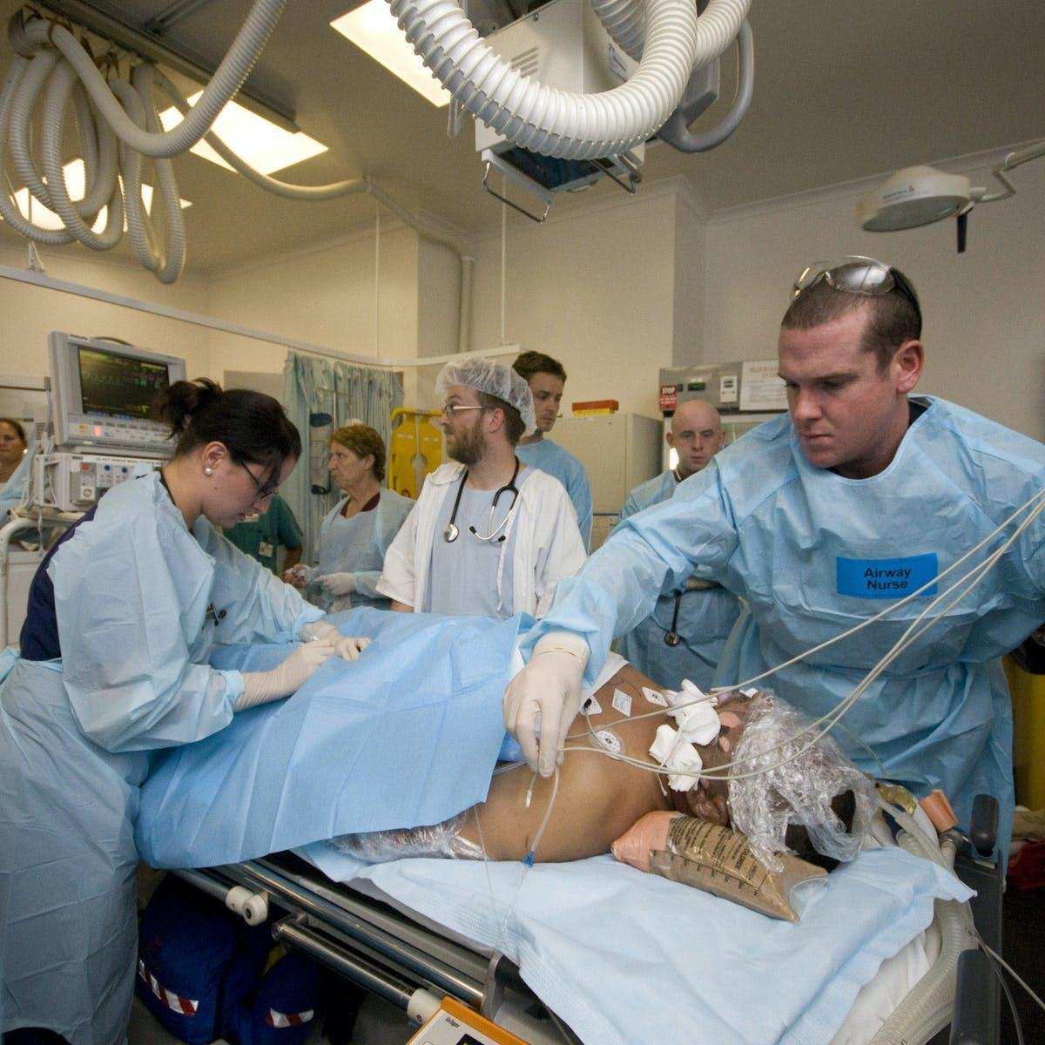
Current Systems
Tests to diagnose a heart attack include:
ECG Done to diagnose a heart attack records electrical signals as they travel through your heart
Blood Test Certain heart proteins slowly leak into your blood after heart damage from a heart attack.

Slide 7
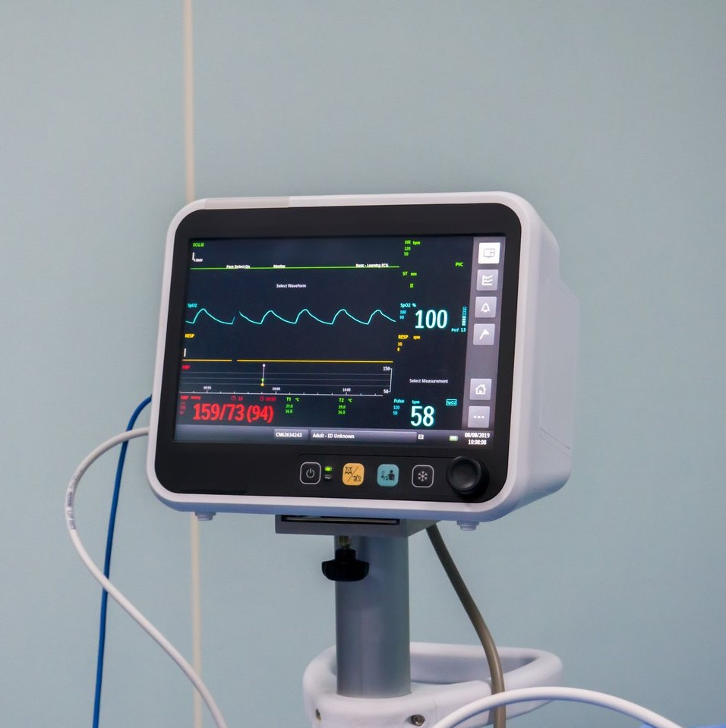
Our System of Detection
Based on:
Chest Pain Type
Blood Pressure
Cholesterol
Blood Sugar
ECG
Maximum Heart Rate
No. of Damaged Vessels
etc.

Slide 8
Let’s Move on to the Project
Thank You

